Slide 1
Usage based Tag enhancement of Images
Project taken at
Big data experience lab
Adobe systems
by
Saurabh Verma
Enrollment No. 13114057

Slide 2
Acknowledgements
I would like to take this opportunity to sincerely thank my team members, Balaji Vasan(BEL Adobe), Noman Sheikh(IIT Delhi) and Roshan Kumar(IIT Kanpur) for their collaboration in the project.
I am also thankful to Lab Members for their invaluable ideas and suggestions.
I cannot imagine a successful internship without Akash Gupta and Sai Varun who were always available.
I am highly indebted to Prof. Niloy Ganguly(IIT Kharagpur) for making the project reach these heights.
This internship would not have been possible without Smitha, Anand and Ameena, internship coordinators.

Slide 3
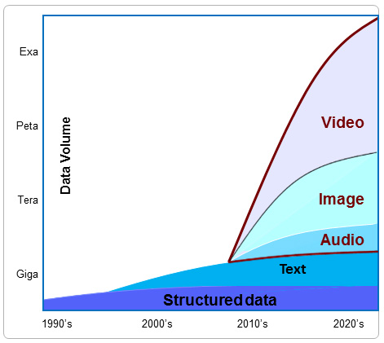
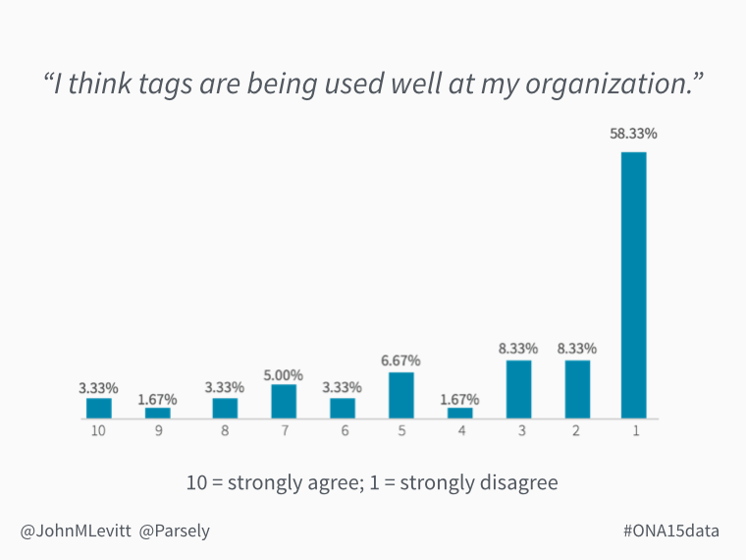
What is tagging? Why do we need it?
https://avindh2014.wordpress.com/background/
http://blog.parsely.com/post/2565/ona15data-a-year-in-data-from-parse-ly/parse-ly/

Slide 4
What if there was a system that could bridge the gap between what images contain and how they are perceived?
What if there was a system that can give a set of tags that maximizes their significance in retrieval?

Slide 5
Problem statement: Given an image and set of associated content, enhance the set of tags based on it's usage
Develop a semantic understanding of the image content
Enhance a given set of tags using background knowledge
Improve retrieval and recommendation by using the given tags

Slide 6
Running Example
http://www.npr.org/sections/parallels/2016/03/22/471401729/in-vulnerable-europe-a-third-major-terrorist-attack-in-a-year

Slide 7
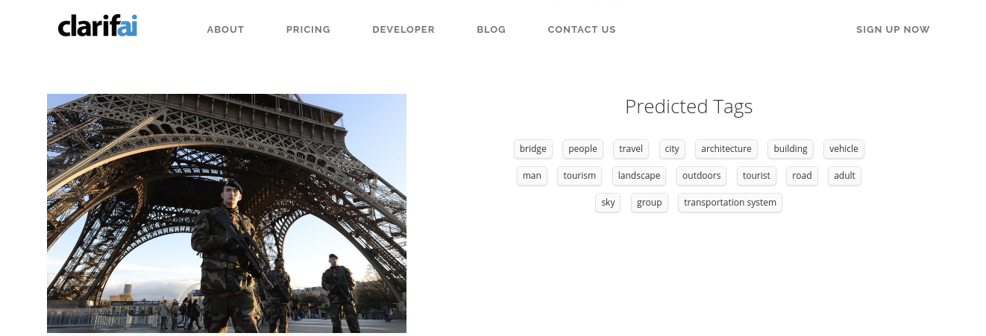
Tags from Clarifai API
https://www.clarifai.com/#demo

Slide 8
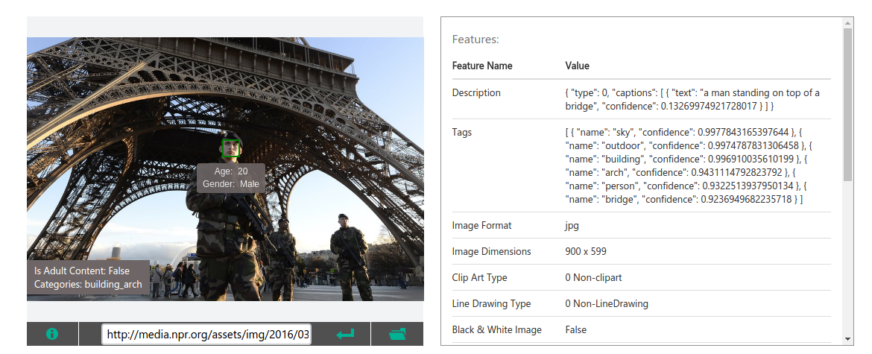
Tags from Microsoft Vision API
https://www.microsoft.com/cognitive-services/en-us/computer-vision-api

Slide 9
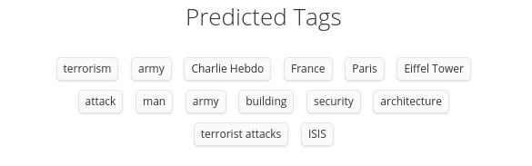
Tags derived by our pipeline

Slide 10
Prior Art (Academic)
Text mining for automatic image tagging
Leong et al., Proceedings of the 23rd International Conference on Computational Linguistics: Posters. Association for Computational Linguistics, 2010.
Zhang, Dengsheng, Md Monirul Islam, and Guojun Lu. Pattern Recognition 45.1 (2012): 346-362.
A review on automatic image annotation techniques

Slide 11





Prior Art (Industry)
https://cloud.google.com/vision/
https://www.microsoft.com/cognitive-services/en-us/computer-vision-api
https://www.ibm.com/watson/developercloud/visual-recognition.html
https://imagga.com/solutions/auto-tagging.html
https://www.clarifai.com/api

Slide 12
Workplan
Week 1-2 : Brainstorm
Week 3: Problem Alternative
Week 4: Solution Framework
Week 12: Documentation
Week 5-8: Coding & Testing
Week 9-10: Evaluation & Tuning
Week 11: Final Presentation

Slide 13
Objectives
Combine visual and textual features for tagging of images
Enhance the given set of tags using background knowledge from large knowledge bases
Use the final tags to improve retrieval and recommendation engines
Develop a cross-platform and re-entrant pipeline

Slide 14
Solution Framework

Slide 15
Entity Parsing and Processing: Process text to extract out relevant information
Representation: Devise a suitable representation for textual information
Unifier: Unify tags from multiple features
Enhancement: Use background knowledge to enhance the tags
Extraction: Give out conventional key-value pair representation of tags for end use

Slide 16
Evaluation & Results

Slide 17
Experimental Setup
Dataset
Leong et al. "Text mining for automatic image tagging." Proceedings of the 23rd International Conference on Computational Linguistics: Posters. ACL, 2010.
Tools
Stanford CoreNLP
http://lit.csci.unt.edu/index.php/Downloads
YAGO-NAGA
Word2Vec and Doc2Vec

Slide 18
Metrics
Significance
Lu, et al. "A Content-Based Method to Enhance Tag Recommendation." IJCAI. Vol. 9. 2009.
Relevance
Resnik, Philip. "Using information content to evaluate semantic similarity in a taxonomy." arXiv preprint cmp-lg/9511007 (1995).
Diversity
Sokal, et al. "The comparison of dendrograms by objective methods." Taxon (1962): 33-40.

Slide 19
Baselines
Imagga
Microsoft Vision
Text mining for automatic image tagging
Gold-standard Human Annotations and Visual autotagging engine
http://lit.csci.unt.edu/index.php/Downloads
https://imagga.com/auto-tagging-demo
https://www.microsoft.com/cognitive-services/en-us/computer-vision-api
Leong et al. "Text mining for automatic image tagging." Proceedings of the 23rd International Conference on Computational Linguistics: Posters. ACL, 2010.

Slide 20
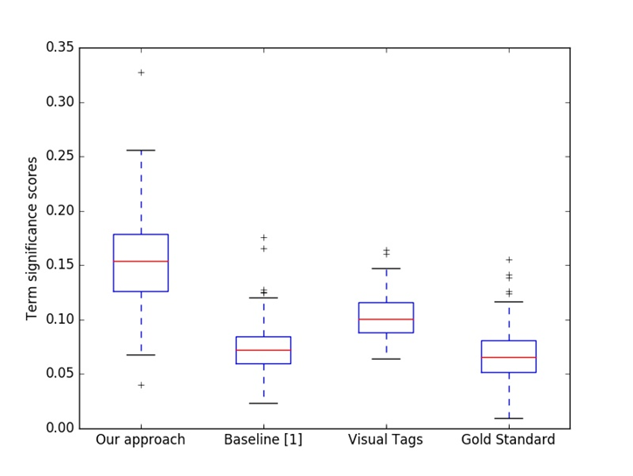
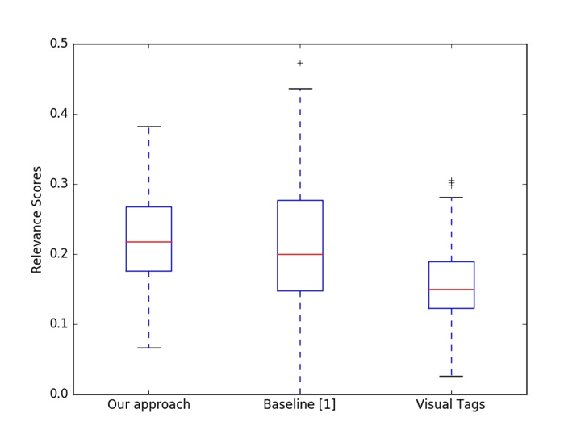
Results

Slide 21
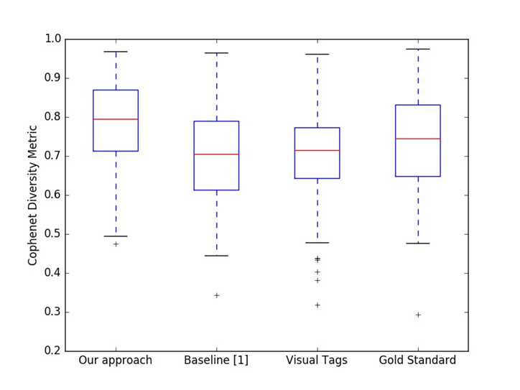
Results

Slide 22
Future Work
Extend this work for multimedia content using the same principal pipeline
Capture multiple word senses in associated content.
Parallelize and optimize the application for low latency solution
Offer solution for rarely used images
Measure the performance of each component and tune them

Slide 23
Intellectual Property
Paper
We are pushing for a publication in WWW 2017 where submission is due on October 24 with the title "Usage based Tag enhancement of images"
Invention Disclosure
We have drafted an invention disclosure which is pending approval.

Slide 24
Thank you

